Slide 1
Applicant Tracking System

Slide 2
Presented by : Group 13
Nikhil Chandra raj potlapally [2830642]
Rakesh varma samala [2836947]
Sandeep kumar torlikonda [2827770]

Slide 3
APPLICANT TRACKING SYSTEM
An Application Tracking System for recruiters simplifies the recruiting process to screen for the best, most qualified candidates.
Since there are many open positions that can attract hundreds or even thousands of candidates without the necessary qualifications, this saves recruiters and companies time that would otherwise be spent manually screening out these candidates.

Slide 4
Goals And Objectives
The principal goal of our ATS is to provide a central location and database for a company’s recruitment process with the objective of better assisting the management of resumes and applicant information. Data is collected from internal applications via the ATS front-end, located on the company website, or extracted from applicants on job boards. Most jobs and resume boards have partnerships with ATS software providers to provide parsing support and east data migration from one system to another.

Slide 5


How Does ATS Work
Candidates are looking for application processes that are easy, fast, and user-friendly. The best applicant tracking systems allow job seekers to easily apply for a position from any device without needing to create a login. This means that companies benefit from a larger pool of applicants, which can then be ranked based on skills and experience.

Slide 6
Benefits of ATS
Saves Time for Value Added Work
Flexible System for Both Employer and the Agency
Better Overview of Applications
Easy Job Posting
Improved Cost-Per-Hire
Improved Quality of Hire
Faster & Better Decisions
Promotes Collaborative Hiring

Slide 7
DESIGN

Slide 8
DESIGN
We have followed every basic principle to design our ATS software to be effective and efficient in day-to-day usage and design it to be best suited for the user’s needs and functions. We have focused on making it the best combination of how it looks and how easy it is to use.
We have ensured that every page and section of our ATS has a clear and definitive purpose that it aims to address, this range from giving all relevant information in visualized format on the dashboard to in-depth information on each and every page of our functionality, therefore we have kept it clean and simple but purposeful and built it to fit directly in line with the user’s wants.

Slide 9
DESIGN
Every aspect of our website has a clear purpose, if it takes too to load, then it’s all but useless to the user. To provide a good user experience we have given our main focus to make it fast and reliable for the user.
We have given the full focus on the typography of the website, as our users, most of the time will spend time reading and searching, it becomes a major aspect to put our focus on and build it perfectly.
One of the most important principles of designing is to have clear and consistent communication, as our users want information quick, so our output and result have to be straightforward and easy to digest.

Slide 10
DESIGN
FEATURES
Dashboard
Openings
Candidates
Pipelined
Placement
Account
Login
Register
Reports On the go
SignOut
Authentication
Workings

Slide 11
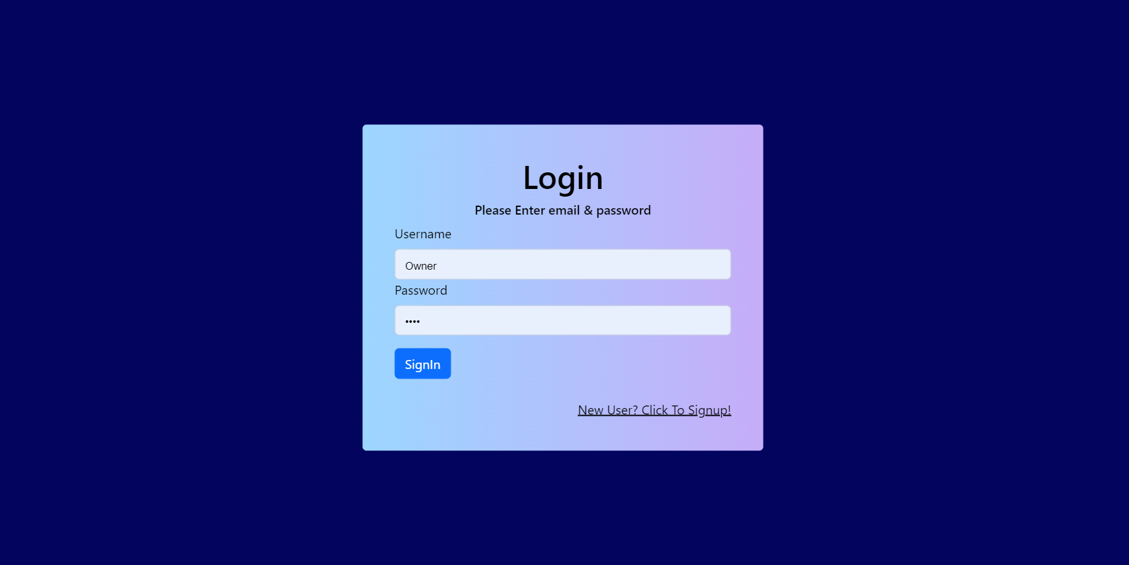
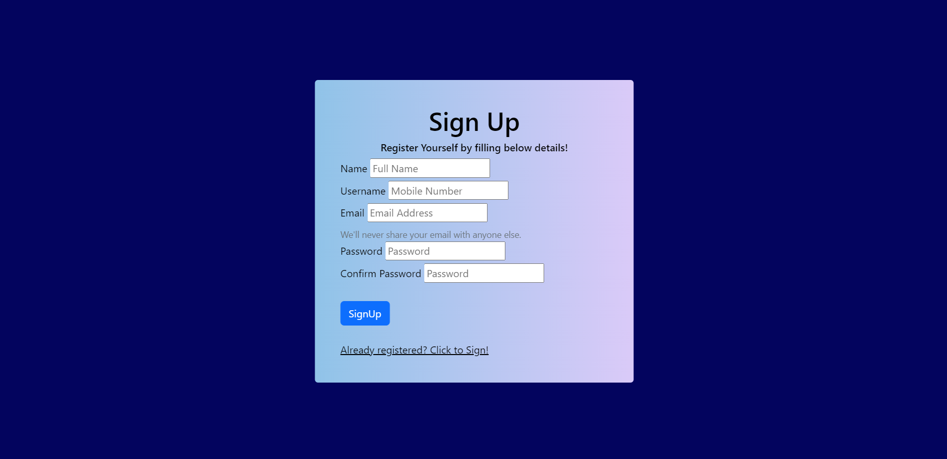
Authentication
DESIGN
Login
Register

Slide 12
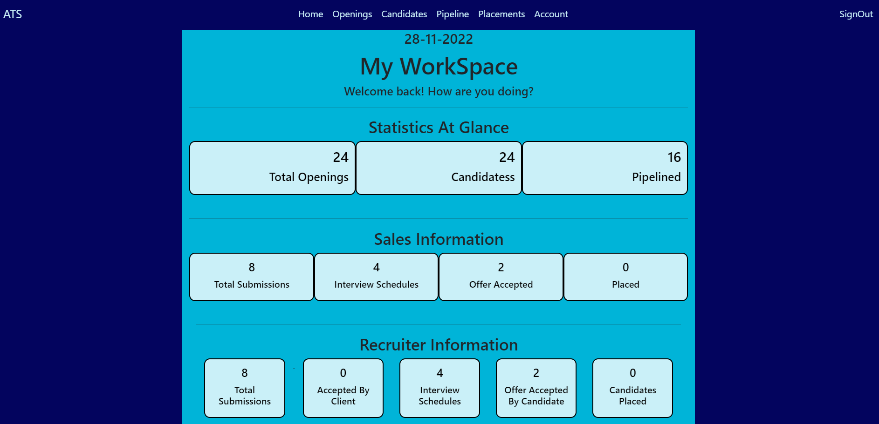
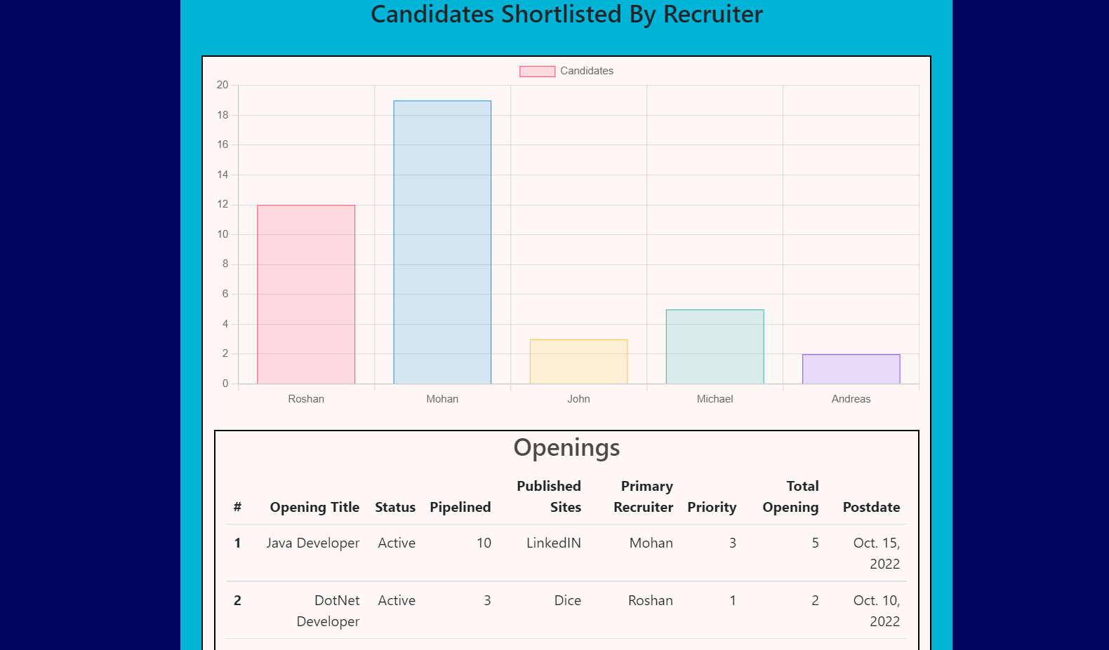
Dashboard
DESIGN
On-the-go information about all the workings of the organization is shown here on the home page.
Under Statistics at glance, data about total openings, Candidates, and Pipelined Candidates are shown.
All the major reports for Sales are shown under Sales Information.
All the information about the recruiters is fetched under Recruiters Information.
An report of recruiter-wise analysis is visualized via a bar graph.

Slide 13
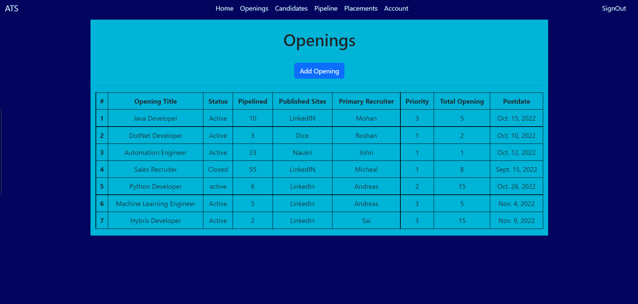
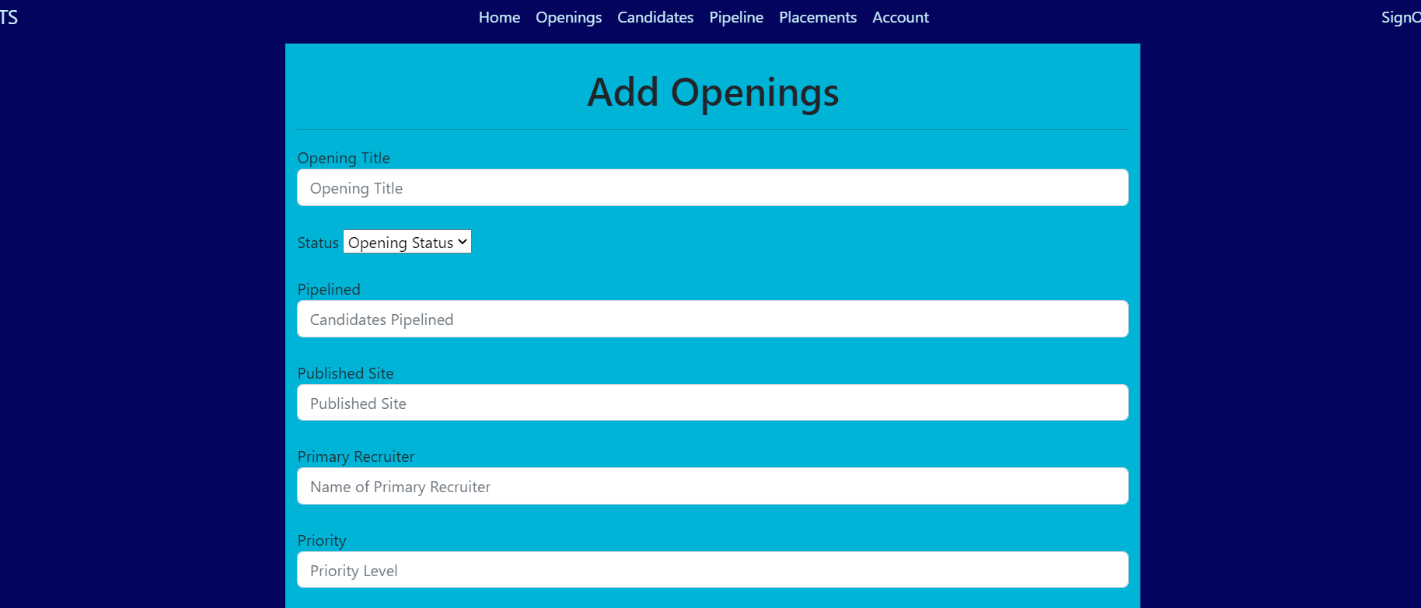
Openings
DESIGN
All the job openings in the organizations are shown here.
You can add new openings by clicking on Add Openings button and then filling up the form.

Slide 14
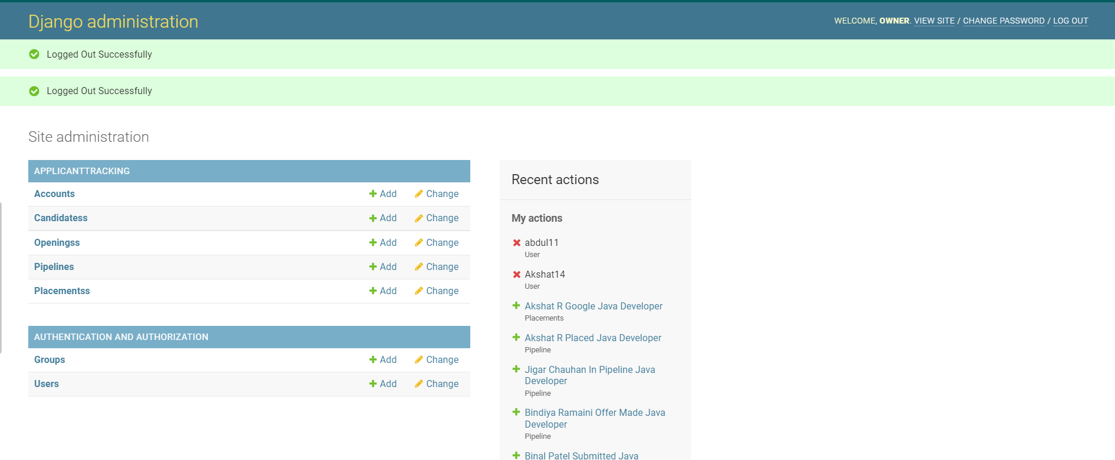
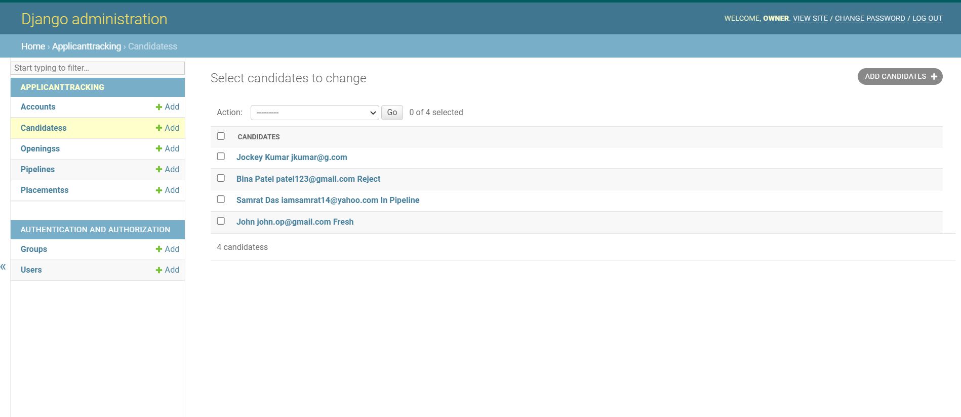
Django Admin
DESIGN
All the databases of the placed candidates are shown here.

Slide 15
DJANGO
CODING
HTML
CSS

Slide 16
CODING
Django is a Python Framework that is used to develop websites using Python, it takes care of the difficult stuff so that you can concentrate on building web applications. Django Follows the MVT(Model, View & Template) design pattern.
Standard markup language for creating webpages.
CSS describes how HTML elements are to be displayed on the screen, paper, or in other media.
DJANGO
HTML
CSS
Frameworks Used

Slide 17
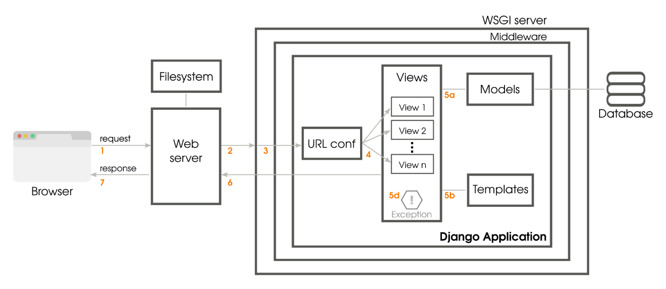
DJANGO
CODING
We choose to go with it because it emphasizes the reusability of the components also referred to as DRY(Don’t Repeat Yourself), and it comes with ready-to-use features like a login system, database connection, and CRUD operations.
As we are building an Applicant Tracking System(ATS), in which the database plays a major role, Django can be very handy for this purpose.

Slide 18
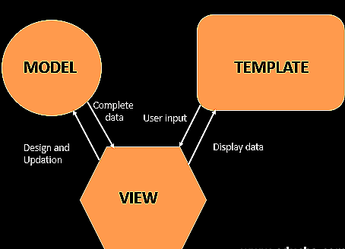
DJANGO
CODING
Django follows the MVT design pattern-Model View Template.
Model-The data you want to present, usually from a database.
View-A request handler that returns the relevant template and content – based on the request from the user.
Template-A text file containing the layout of the web page, with logic on how to display the data.

Slide 19

DJANGO
CODING
Complete Procedure:
Django receives the URL, checks the urls.py file, and calls the view that matches the URL.
The view described in the views.py, checks for relevant models.
The models are imported from the model.py file.
The view then sends the data to a specified template in the template folder.
The template contains the HTML tags and the data it returns finished HTML content back to the browser.

Slide 20
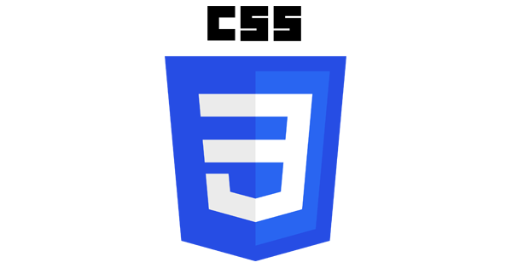
HTML & CSS
CODING
We are using HTML, Hypertext Markup Language for creating Web Pages. It describes the structure of the web pages and contains a series of elements and these elements tell the browser how to display the content.
With the combination of HTML and CSS we have designed and styled our web pages. CSS(Cascading Style Sheets) is the language we used to style out HTML documents and it describes how HTML elements are displayed on the screen, paper, or in other media. It saves a lot of words, it can control the layout of multiple web pages all at once.

Slide 21
TESTING
Unit
Test

Slide 22

TESTING
We are using the Unit test framework present in python to check our Django website, It is a first-level software testing tool. In this, we have created a text fixture of baseline for running the tests to ensure that it is a fixed environment. After that various test cases are made in order to set the conditions which are then used to determine whether a system under test works correctly.

Slide 23
TESTING
Unit Test Framework
We are using the Unit test framework present in python to check our Django website, It is a first-level software testing tool. In this, we have created a text fixture of baseline for running the tests to ensure that it is a fixed environment. After that various test cases are made in order to set the conditions which are then used to determine whether a system under test works correctly.

Slide 24
TESTING
Unit Test Framework
We are performing an automated Unit Test on all the model classes present in order to check the seamless connection between our database and the front end.
All the URLs present in the url.py files are being tested to see the working of all the HTML and CSS templates.
Different views present under the views.py is also tested by Unit test to ensure that all the logic and functionalities are working perfectly.
If any of the test from above fails, an in-depth review of the bug or problem is being conveyed to the programmer in order to get the best solution.

Slide 25
TESTING
Regression Tests
After every change in the codebase of our software, whether it be an addition of a feature or a minor bug fix, we are doing a manual regression test to ensure and verify that the bug has been fixed, and then re-run to ensure that it has not been reintroduced following later changes to the code.
An complete analysis is done post-regression to maintain a record of each and everything.

Slide 26
THANKS!

